Slide 1
CSRF &
SQL-i
By:
Rohit Sehgal
Nishit Majithia
Gaurav Kumar

Slide 2
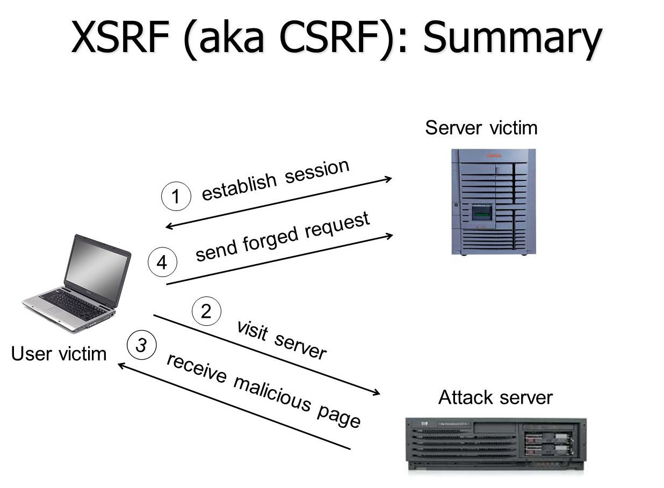
What is CSRF/XSRF/sea-surf ?

Slide 3
Characteristics of CSRF
It involves sites that rely on a user's identity.
It exploits the site's trust in that identity.
It tricks the user's browser into sending HTTP requests to a target site.

Slide 4
What is SQL-i ?
Many web applications take user input from a form
Often this user input is used literally in the construction of a SQL query submitted to a database. For example:
–SELECT productdata FROM table WHERE productname = ‘user input product name’;
SQL injection is placing SQL statements in that user input field.

Slide 5
Example of SQL-i
# Define POST variables uname = request.POST['username'] passwd = request.POST['password'] # SQL query vulnerable to SQLi sql = “SELECT id FROM users WHERE username=’” + uname + “’ AND password=’” + passwd + “’” # Execute the SQL statement database.execute(sql)

Slide 6
Types of SQL-i ?
Error Based SQL-i
Blind SQL-i

Slide 7
Let’s see NATAS

Slide 8
THANK YOU!!

